Slide 1



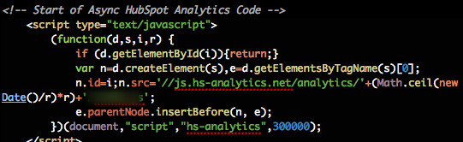
JavaScript Applications
Course Introduction
SoftUni Team
Technical Trainers
Software University
http://softuni.bg

Slide 2


Table of Contents
Course Objectives
Course Program
Trainers Team
Examination
Learning Resources

Slide 3


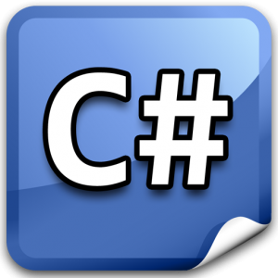


Level #2 at the Software University
Object-Oriented Programming
11 times + TW + exam
6 weeks * 2 times
JavaScript OOP
5 times + exam
3 weeks * 2 times
JavaScript Applications
6 times + TW + exam
4 weeks * 2 times
AngularJS
4 times + project
3 weeks * 2 times
High-Quality Code
16 times + team work project (TW) + Exam
16 weeks * 1 times

Slide 4

JavaScript Applications
Course Objectives & Program

Slide 5


JavaScript Applications – Course Program
Course Introduction – course program, exams, trainers, evaluation, resources
jQuery Overview – introduction in jQuery, DOM manipulation, event handling
BaaS and Parse.com – Backend as a Service, BaaS platforms, using Parse.com
Web Storages – cookies, session storage, local storage, shivs and shims
HTTP, AJAX and REST – WWW, URL, JSON, RSS, HTTP, AJAX, JSONP, REST
Consuming REST Services – AJAX, jQuery AJAX, accessing REST services
Promises and Async Programming – callback-oriented programming, promises, promise libraries
Underscore.js – functions over collections, arrays…
Unit Testing with Jasmine – TDD, BDD, Mocha & Chai
Practical Exam

Slide 6

Warning: Not for Absolute Beginners
The "JavaScript Applications" course is NOT for absolute beginners
Take the "JavaScript OOP" course at SoftUni first: https://softuni.bg/courses/javascript-oop
The course is OK for beginners, but requires previous coding skills
Requirements
JS coding skills – entry level
Computer English – entry level
Logical thinking
coding skills
required!

Slide 7

The Trainers Team

Slide 8
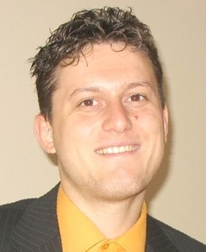
Trainers Team
Svetlin Nakov, PhD
Training & Inspiration Manager @ Software University
20+ years software development experience
10+ years experience as trainer
Author of 7 programming books
Speaker at hundreds of events
Web site & blog: www.nakov.com

Slide 9


Trainers Team (2)
Vladimir Georgiev
Software engineer and Trainer @ Software University
Top performing graduate from the Software Academy (2013)
Volunteer Trainers / Assistants
Top students from SoftUni
Will teach workshops / advanced topics / labs

Slide 10

JavaScript Applications: More Details
Duration, Languages, Technologies

Slide 11


Training Duration – JavaScript Applications
Lectures: ~ 12 hours (onsite + YouTube videos)
Practical exercises (in class): ~ 12 hours
Homework: ~ 30-50 hours
Team project: ~ 10-20 hours
Exam preparation: 4 hours
Exam: 4-6 hours
Schedule: Nov-Dec 2014
Exam dates: ~ 11-14 December 2014

Slide 12



Why English?
Why the slides are in English?
English is the native language of the software engineers
Specific terminology should be in English
Translations are inaccurate and funny
Just learn English!
No excuses

Slide 13



JavaScript Applications
Evaluation Criteria

Slide 14

Scoring System for the “JavaScript Applications”
Exam – 80%
Labs – up to 10% of the exam
Teamwork – 10%
Homework + evaluation – 5% + 5%
Presence in class: 5% (onsite students only)
Bonuses: up to 10%

Slide 15

JavaScript Applications Exam
1 practical task for 4-6 hours
You are given a REST services
Consume given REST services and visualize data
Your project should be written in JavaScript
Your project should correctly follow principles of high-quality code
Practical programming exam
The total exam score come from code review by the SoftUni team

Slide 16

Homework Assignments
Doing your homework is very important!
Programming can only be learned through a lot of practice!
You should write code every day!
Each lecture is followed by a few exercises
Try to solve them in class
The rest are your homework
Homework assignments are due in 1-2 weeks after each lecture
Submission will be accepted through our web site: softuni.bg

Slide 17

Homework Peer Reviews
Give feedback to a few random homework submissions
Students submit homework anonymously
Please exclude your name from the submissions!
For each homework submitted
Students evaluate 3 random homeworks
From the same topic, after the deadline
Give written feedback, at least 200 characters
Low-quality feedback → report for punishment
Everyone will get feedback for their homework

Slide 18





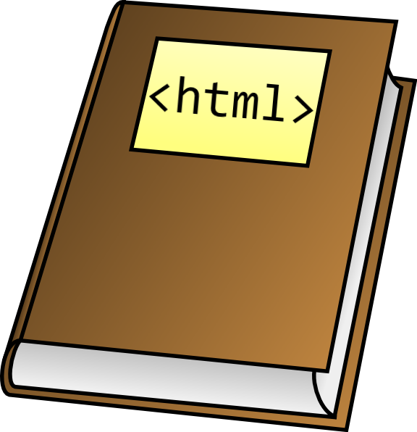



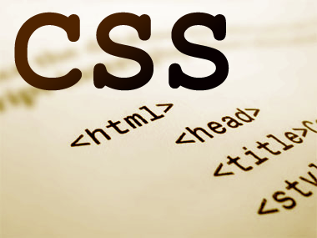
Resources
What We Need Additionally?

Slide 19

Course Web Site & Forums
The JavaScript Applications official web site:
Register for the "Software University Forum":
Discuss the course exercises with your colleagues
Find solutions for all course exercises
Share source code / discuss ideas / help each other
https://softuni.bg/trainings/coursesinstances/details/11
https://softuni.bg/forum

Slide 20



JavaScript Applications Slides and Videos
All lecture slides, videos, homework assignments, projects and other resources are open content, available for free
Visit the course web site to access the course resources

Slide 21


JavaScript Resources
Mozilla Development Network (MDN)
https://developer.mozilla.org
Web Platform
http://www.webplatform.org
JavaScript Books
Programming JavaScript Applications

Slide 22
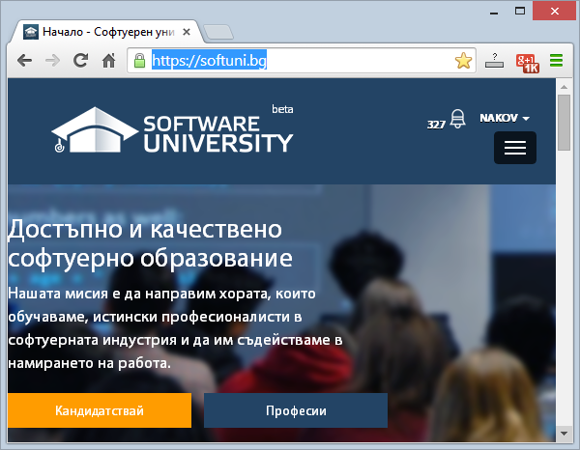
Software University Learning System (SULS)
Software University Learning System (SULS)
www.softuni.bg
Important resource for students
Homework submissions
Homework check-up
Exams and results
Reports about your progress
…

Slide 23


Recommended Software
Microsoft Visual Studio 2013 + Node.js Tools
Sublime Text
WebStorm

Slide 24


Summary
The "JavaScript Applications" course teaches
How to consume REST services and process data
Training program
jQuery, AJAX, BaaS, Web Storages, HTTP, REST, Consuming REST services, promises, underscore.js
Practical exam
Code review
Learning resources
Lectures, videos, software, books, forum
JS Apps

Slide 25







JavaScript Applications
https://softuni.bg/courses/javascript-applications/

Slide 26
License
This course (slides, examples, demos, videos, homework, etc.) is licensed under the "Creative Commons Attribution-NonCommercial-ShareAlike 4.0 International" license
Attribution: this work may contain portions from
"JavaScript Applications" course by Telerik Academy under CC-BY-NC-SA license

Slide 27




Free Trainings @ Software University
Software University Foundation – softuni.org
Software University – High-Quality Education, Profession and Job for Software Developers
softuni.bg
Software University @ Facebook
facebook.com/SoftwareUniversity
Software University @ YouTube
youtube.com/SoftwareUniversity
Software University Forums – forum.softuni.bg

